Slide 1
— LT2319 Project
Interactive Swedish Learning Game — ”Restaurant Ordering” Scenario
Tianyi Geng

Slide 2
Swedish Learning Game
”In the restaurant”
NPC Guidance
User Input
Frog Repeat
NPC Response
Vad kan jag göra för dig?
Vad är menyn?
Vår meny är: …
Vad är menyn?

Slide 3
Technical Components
The system uses the following services, frameworks and APIs:
Services
Azure Speech Service (speech recognition, speech synthesis, multilingual voices)
Framework
Typescript, Xstate (for state update managing), Speechstate (integrates with Xstate and Azure APIs)
APIs
LLaMA API (for identifying user intents and generate natural dialogue responses)
User Interface

Slide 4
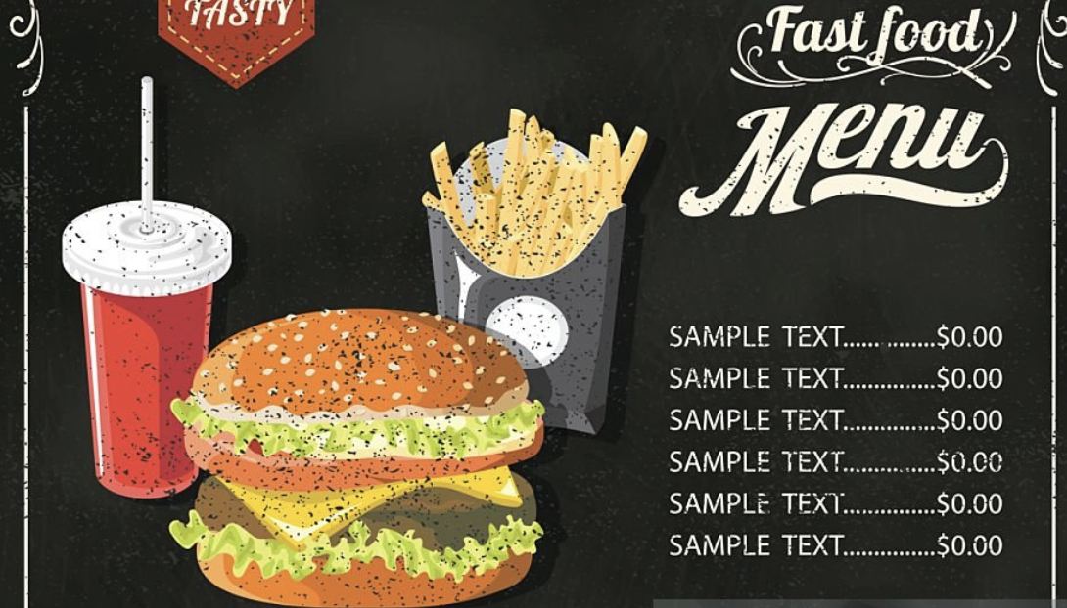
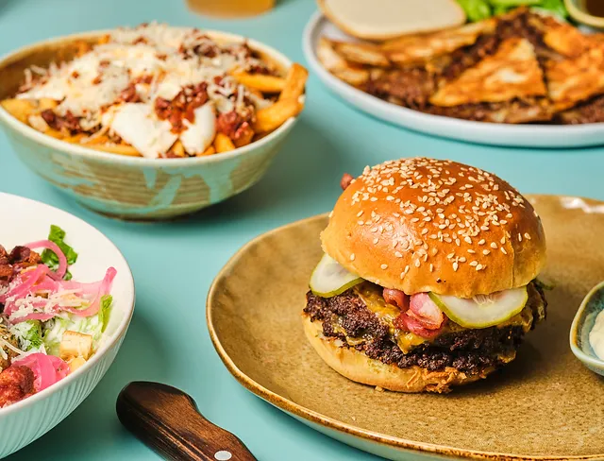
What do you talk about in a restaurant?
Data Collection

Slide 5
User Interface
Click to Talk (Visible speech status)
Cute Character GIFs representing the player and the NPC (”Catshier”)
A few animation changes on the NPC depending on different intents of the player speech
Speech suggestions emerge on the screen as clickable buttons and play pronunciation audio when clicked
Order Confirmation UI for order amount adjustment

Slide 6
Visual “shopping cart”🛒
Implementation
Order Confirmation UI
NPC Confirmation
User Input
Clickable buttons & Audio🎶
Attitude Detection🤔
Show
Suggestions
NPC Response
Intent Detection to Character emotion change 😄😓
Frog Repeat
Order Failed
Order Success
Ordering
START
NPC Guidance
Other intents
User Input
Frog Repeat
NPC Response
END

Slide 7
Sample dialogues based on intents
🧾
Catshier: ”Hej, vad kan jag göra för dig?”
Frog: ”Hej, vad är meny?”
Catshier: ”Javisst. Vår meny är: Wax hamburgare, Wax pommes frites, Wax cola, Wax milkshake.”
Frog: ”Jag vill ha en hamburgare och en cola.”
Catshier: ”Du beställde en hamburgare och en cola. Något annat?”
[Show order confirmation UI, waiting for the player to adjust the amount of the ordered items]
Frog: ”vad är rekommendation?”
Catshier [smiles]: ”Jag rekommenderar vår specialitet - Wax hamburgare med pommes frites och en milkshake. Det är vår mest populära kombination!”
Frog: ”Jag vill ha en helicopter.”
Catshier [confused look]: ”Jag förstår inte.”
🍔
💕
😑

Slide 8
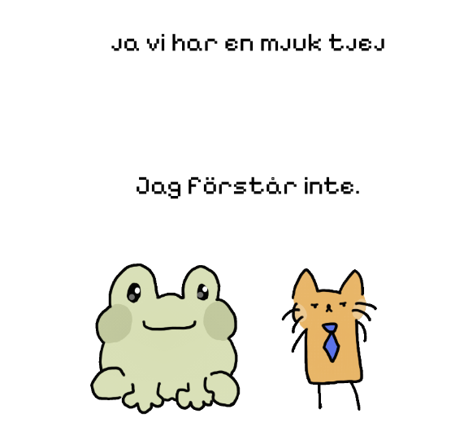
Discussion & Future Plans
Intent Recognition
Azure, LLAMa, or combined?
Better prompts for NLG
LLM for NLG or hard-code scripts?
Limited Language Resources (for now?)
Swedish vs. Bilingual Voices from Azure
NLU Fine-tunning
More interactive and natural responses to the speech
Check if items actually exist in the menu
Detect ”bad stuff”
Speech suggestions based on learner’s Swedish level

Slide 9
Thanks!
Please keep this slide for attribution

